Slide 1
Mechanism advice from the TAs
The TAs have compiled a list of common mistakes we saw on the mechanism found on page 7 of the third homework.
Check out the following slides to see common mistakes that can be easily avoided.

Slide 2
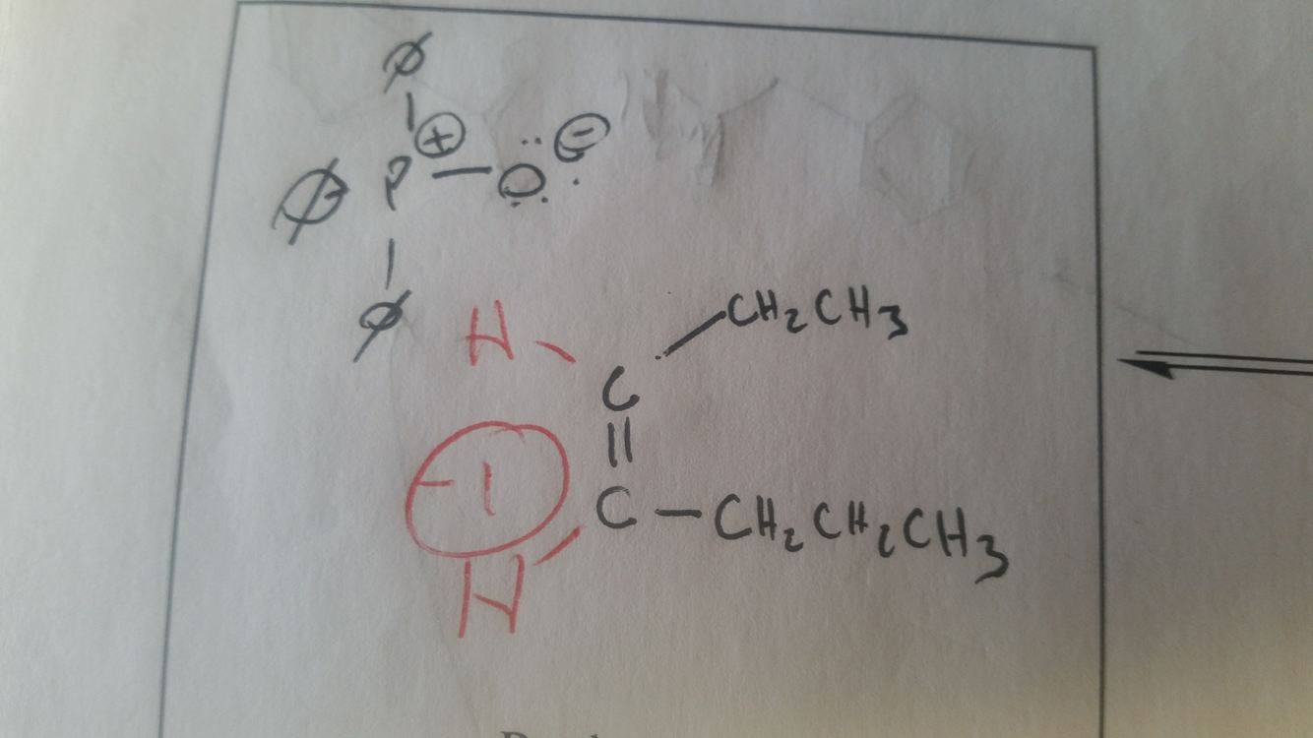
If you write “C” you must draw all bonds!
If you chose to write “C” – you must explicitly draw all atoms bound to it

Slide 3
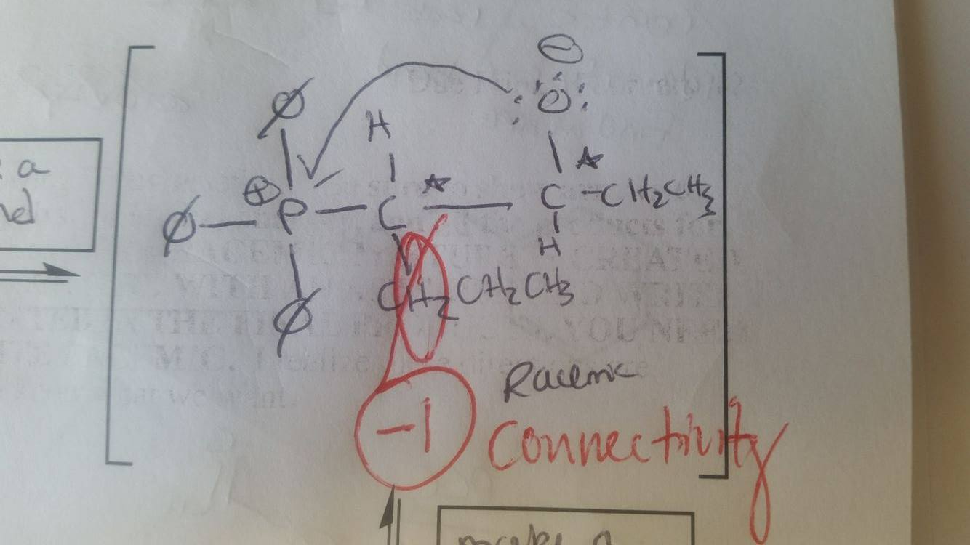
Connectivity matters!
Bonds between two carbon atoms need to be clear.
The bond (which we draw as a line) should be between the two “C” atoms as shown in green. The mistake above is that the bond seems to be between a carbon and a hydrogen atom.

Slide 4
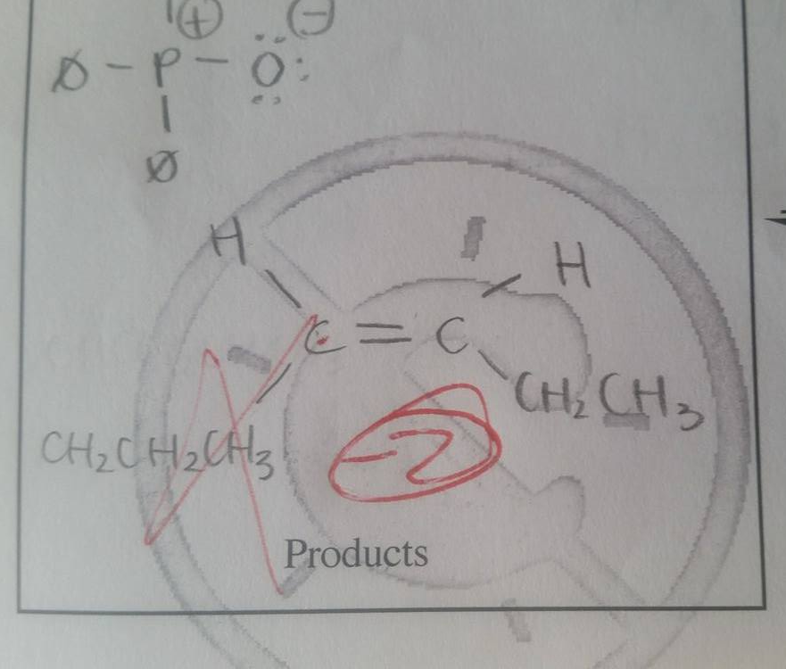
Connectivity Matters II
This example multiple mistakes:
The bond is drawn between the “C” atom of the alkene and an “H” atom of the propyl group.
The bond should be drawn between the “C” atom of the alkene and this“C” atom of the propyl group.

Slide 5
Connectivity Matters III
You shouldn’t draw hydrocarbon tails vertically when using letters (e.g. –CH₂-).
If you must draw hydrocarbon tails vertically using letters, clearly draw the bonds between “C” atoms of the methylene units (see the green lines). Again, we don’t like to see this.

Slide 6
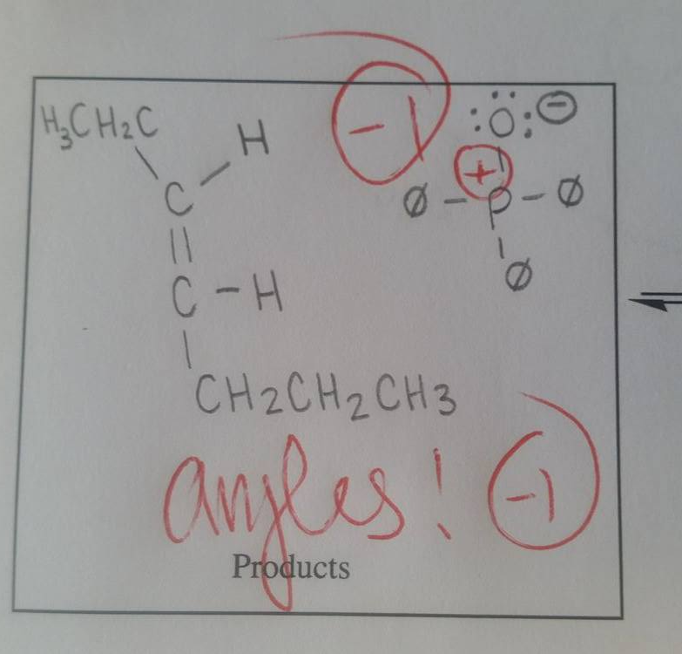
Angles Matter I
As drawn in grey, the angles between groups bound to this carbon are good because they are all ~120˚ (Note the connectivity issue – the proper bond is shown in green)
Poorly drawn angles – does not represent the “Z” product that is actually produced
Alkenes (sp²) – 120˚ angles
Alkynes (sp) – 180˚ angles

Slide 7
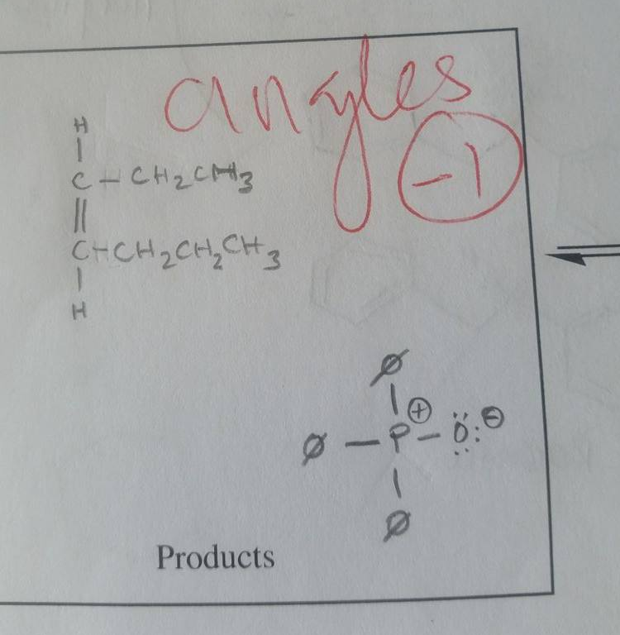
Angles Matter II
Alkenes (sp²) – 120˚ angles
Alkynes (sp) – 180˚ angles
Here is another example of
poorly drawn angles around
an sp² hybridized carbon.

Slide 8
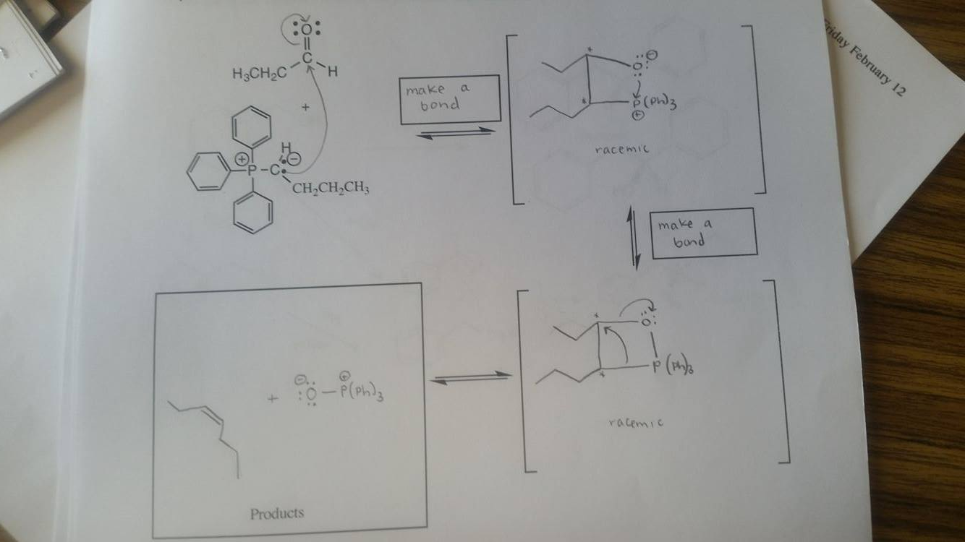
Line-angle drawings are accepted
You don’t have to write “C” for every Carbon atom in a mechanism unless you want to!
This mechanism is perfectly correct as drawn.

Slide 9
The Four Basic Mechanistic Elements
Make a bond
Break a bond
Add a proton
Take a proton away
Does not include:
“Creation of four membered ring”
“Remember this step”

Slide 10
Read the instructions
Instructions are long and detailed – get used to them now! They are there for a reason.

Slide 11
Arrows come from lone pairs/bonds
Arrows DO NOT COME FROM CHARGES

Slide 12
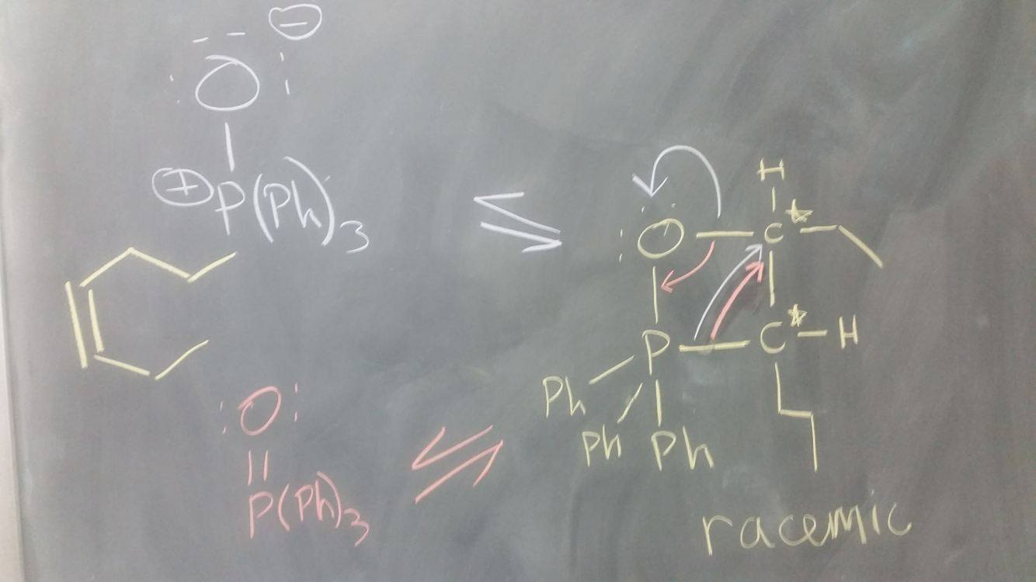
Follow your arrows!
(TOP) Purple: if you push your arrow to oxygen, make sure those electrons follow that arrow, here becoming a lone pair!
(BOTTOM) Red: if you push an arrow to form a bond, make sure those electrons follow that arrow and become a bond!
Both are correct as long as you draw the product that would form as a result of your arrow pushing!

Slide 13
Draw all products created in mechanisms
In the final step of the Wittig mechanism, you create (Ph)₃P⁺-O⁻
→ you need to draw everything that is produced in the previous step

Slide 14
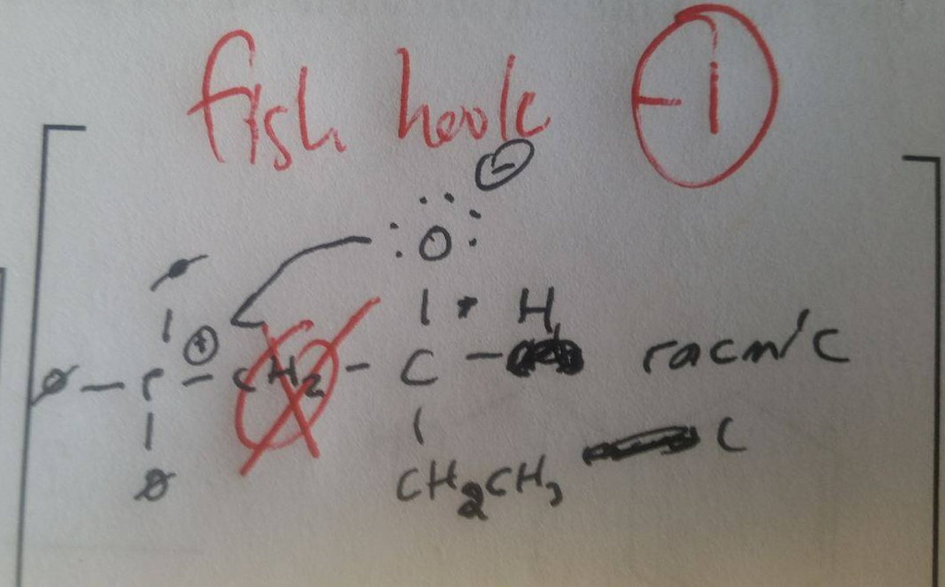
Make double headed arrows obvious
Fish hook arrows are for radicals, not lone pairs. The arrow drawn below implies a single electron is involved in bonding. Also, the arrow should be pointing to the “P” atom – NOT the formal charge.

Slide 15
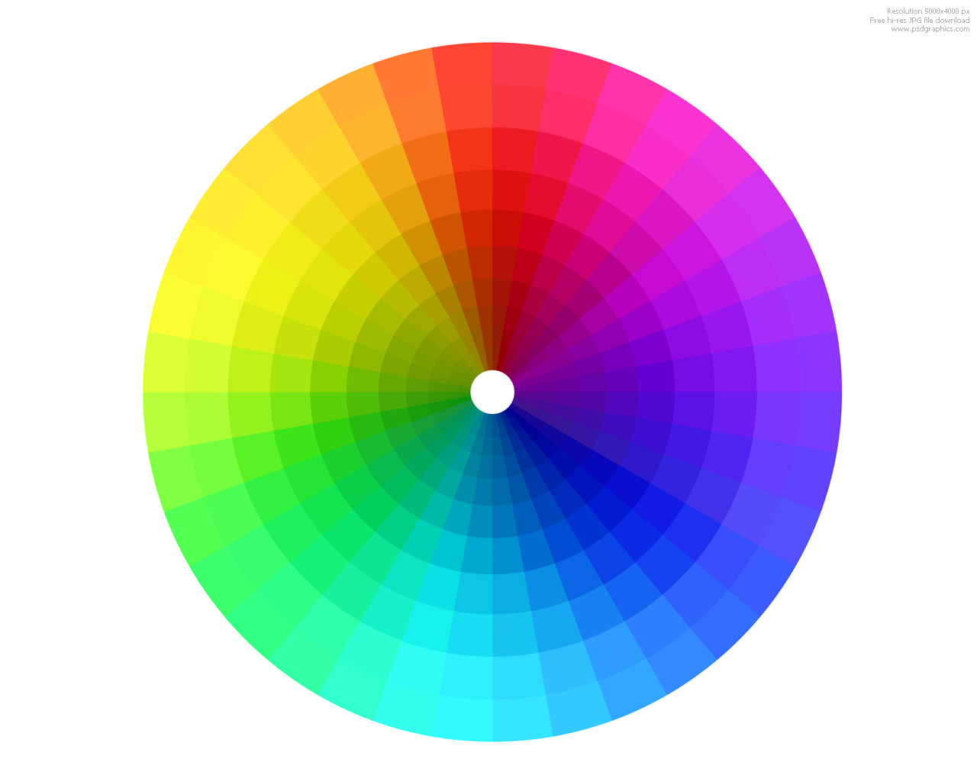
DO NOT USE ANY COLOR CLOSE TO RED
DON’T USE
RED
ORANGE
BROWN
PURPLE
PINK
MAUVE
LILAC
ETC

Slide 16
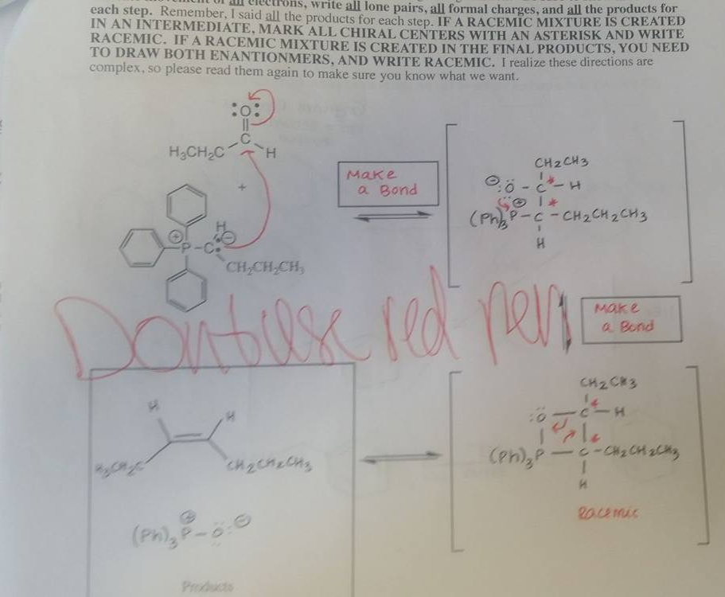
Moving forward, we will no longer grade anything written in any color resembling red. We encourage you to use colors like black, blue, green, or grey if you want to write in multiple colors.

Slide 17
Read the info on the website
We know there is a lot of information for you on the website, but ALL of it is there to help you.

Slide 18
Talk to the TAs if
You don’t know why you lost points on a problem
You need help in the class

Slide 19
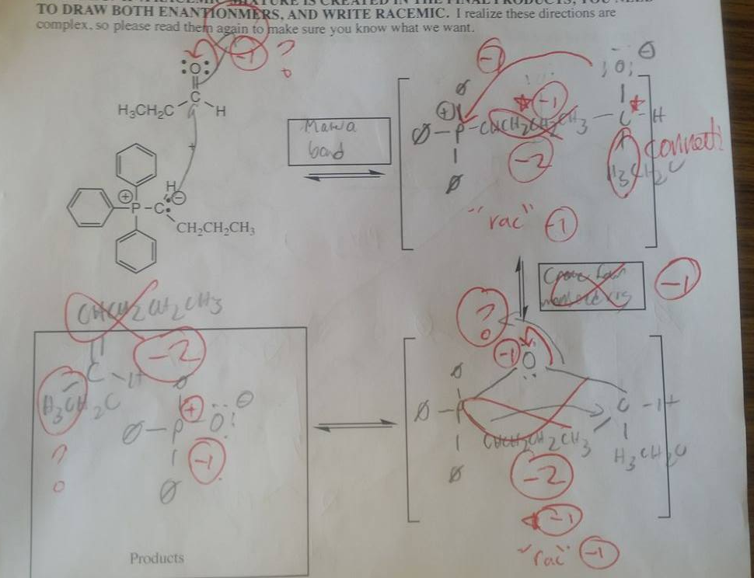
If you don’t understand why we marked something wrong, ask us!

